Slide 1
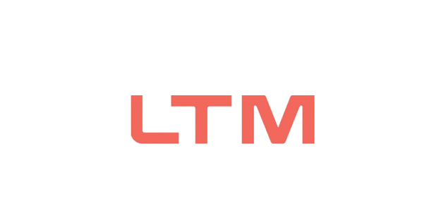

MTech Program
Advanced Industry Integrated Programs
Jointly offered by University and LTIMindTree
Review II
Project Title I
Self-Corrective RAG with Adaptive Evidence Verification for Hallucination-Resistant Answer Generation
SOWMIYA C
T9954
CRESCENT COLLEGE
Knowledge partner | Implementation partner

Slide 2

Self Corrective RAG With Adaptive Evidence Verification
Introduction
Retrieval-Augmented Generation (RAG) combines information retrieval with large language models to generate accurate answers.
Traditional RAG may retrieve irrelevant or insufficient evidence, leading to hallucinated responses.
This project introduces a self-corrective RAG system that verifies retrieved evidence before generating the final answer.
The system improves answer accuracy, reliability, and faithfulness through adaptive evidence verification and correction.

Slide 3
Self Corrective RAG With Adaptive Evidence Verification
Objective
To develop a self-corrective Retrieval-Augmented Generation (RAG) system.
To retrieve relevant and reliable evidence for user queries.
To verify the retrieved evidence before generating answers.
To identify and correct hallucinated or unsupported responses.
To improve answer accuracy, faithfulness, and reliability.
User Question → Retrieval → Evidence Verification → Self-Correction (if needed) → Answer Generation → Final Answer

Slide 4
Self Corrective RAG With Adaptive Evidence Verification
Module name
Data Preparation: Processed Hotpot QA dataset for knowledge retrieval.
Vector Indexing: Generated embeddings and stored them in Chroma DB.
Retrieval Engine: Retrieved relevant documents using semantic search.
Answer Generation: Generated responses using retrieved evidence.
Evidence Verification: Validated answers against supporting documents.
Self-Correction: Re-retrieved evidence and refined answers when verification failed.
Hallucination Detection: Identified unsupported claims and improved reliability.
Evaluation: Tested on questions with faithfulness and accuracy metrics.

Slide 5
Self Corrective RAG With Adaptive Evidence Verification
Methodology/Modeling Plan
Document Collection and Preprocessing
  Collect source documents and clean the text for indexing.
Knowledge Base Creation
  Generate embeddings and store documents in Chroma DB for efficient retrieval.
Question Retrieval and Answer Generation
  Retrieve relevant document chunks and generate answers using an LLM.
Adaptive Evidence Verification
  Validate generated answers against retrieved evidence and assign a verification score.
Self-Correction and Evaluation
  Re-retrieve information, regenerate answers when verification fails, and evaluate performance using test questions.

Slide 6
Self Corrective RAG With Adaptive Evidence Verification
Data preprocessing & EDA
Source Document Preparation
  Collected and organized knowledge source documents for the RAG system.
Text Chunking
  Split large documents into smaller chunks for efficient retrieval.
Vector Embedding Creation
  Converted text chunks into embeddings for semantic search.
Chroma DB Index Generation
  Stored document embeddings in Chroma DB for fast similarity retrieval.
Knowledge Base Analysis
  Verified document quality, chunk distribution, and retrieval readiness before indexing.

Slide 7
Self Corrective RAG With Adaptive Evidence Verification
Approach/Algorithms/Tools
Approach
• Developed a Self-Corrective RAG framework that generates answers from retrieved evidence and reduces hallucinations through verification and correction.
Algorithms
• Semantic Retrieval to fetch relevant documents from Chroma DB using vector embeddings.
• Retrieval-Augmented Generation (RAG) to generate answers using retrieved context.
• Adaptive Evidence Verification to validate generated answers against supporting evidence.
• Hallucination Detection & Self-Correction Loop to identify unsupported claims and refine responses through re-retrieval.
Tools
• Python, Stream lit, Fast API, Chroma DB, Lang Chain, Sentence Transformers, Hotpot QA, GitHub, Railway, Streamlit Cloud.

Slide 8
Self Corrective RAG With Adaptive Evidence Verification
Project plan/milestones progress
1: Requirement Analysis
Studied RAG systems and hallucination issues in LLMs.
2: Knowledge Base Setup
Prepared documents and created the Chroma DB vector database.
3: Self-Corrective RAG Development
Implemented retrieval, answer generation, verification, and correction modules.
4: System Integration & Deployment
Integrated all modules and deployed using Stream lit and Railway.
5: Testing & Validation
Tested system performance, verified responses, and analysed evaluation metrics.

Slide 9
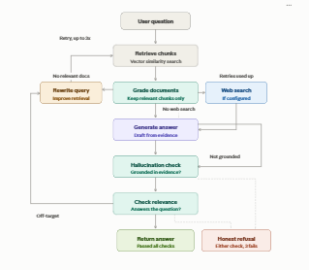
Self Corrective RAG With Adaptive Evidence Verification
Pipeline structure
User Query
↓
Document Retrieval
↓
Answer Generation
↓
Evidence Verification
↓
Hallucination Detection
↓
Self-Correction Loop
↓
Final Verified Answer

Slide 10
MTech Program
Advanced Industry Integrated Programs
Jointly offered by University and LTIMindTree
Review II
Project Title II
Hierarchical Multi-Agent AI for Autonomous Task Decomposition, Planning, and Collaborative Execution
SOWMIYA C
T9954
CRESCENT COLLEGE
Knowledge partner | Implementation partner

Slide 11
Multi-Agent AI for Autonomous Task Decomposition, Planning, and Collaborative Execution
Introduction
Multi-Agent AI uses multiple intelligent agents to solve complex tasks collaboratively.
The system divides a complex task into smaller subtasks using hierarchical task decomposition.
Different agents perform planning, reasoning, and execution according to their assigned roles.
Agents communicate and share results to improve coordination and task completion.
The proposed system aims to provide autonomous, efficient, and reliable task execution.

Slide 12
Multi-Agent AI for Autonomous Task Decomposition, Planning, and Collaborative Execution
Objective
To develop a hierarchical multi-agent AI system for autonomous task solving.
To decompose complex tasks into smaller and manageable subtasks.
To assign subtasks to specialized agents based on their roles and capabilities.
To enable agents to communicate, coordinate, and share results effectively.
To achieve efficient, autonomous, and reliable task planning and execution.

Slide 13
Multi-Agent AI for Autonomous Task Decomposition, Planning, and Collaborative Execution
Module name
Module 1 - Manager Agent
Decomposes the user goal into high-level tasks.
Module 2 - Supervisor Agent
Monitors workflow and divides tasks into subtasks.
Module 3 - Worker Agent
Executes assigned tasks and generates outputs.
Module 4 - Shared Memory Module
Stores and shares information among agents.
Module 5 - Result Aggregation Module
Combines agent outputs and produces the final result.

Slide 14
Multi-Agent AI for Autonomous Task Decomposition, Planning, and Collaborative Execution
Methodology/Modeling Plan
Step 1 - Goal Input
User provides a high-level goal to the system.
Step 2 - Task Decomposition
Manager Agent analyses the goal and creates major tasks.
Step 3 - Subtask Generation
Supervisor Agent breaks major tasks into smaller actionable subtasks.
Step 4 - Task Execution
Worker Agents execute the assigned subtasks collaboratively.
Step 5 - Result Generation
Shared Memory stores outputs and the system consolidates final results.

Slide 15
Multi-Agent AI for Autonomous Task Decomposition, Planning, and Collaborative Execution
Data preprocessing & EDA
Data Processing
Goal Input Collection
Goal Analysis
Task Extraction
Task Prioritization
EDA (Exploratory Goal Analysis)
Goal Pattern Analysis
Task Distribution Analysis
Goal Complexity Assessment
Subtask Identification
Execution Flow Analysis

Slide 16
Multi-Agent AI for Autonomous Task Decomposition, Planning, and Collaborative Execution
Approach/Algorithms/Tools
Approach:
Hierarchical Multi-Agent Architecture for Autonomous Task Decomposition and Collaborative Execution.
Algorithms:
Goal Decomposition Algorithm
Hierarchical Task Planning
Task Allocation Strategy
Agent Coordination Mechanism
Result Aggregation Process
Tools
Python, Stream lit, GroqAPI, Lang Chain, Py test, VS Code, Python Dotenv, Git, GitHub, Virtual Environment (venv)

Slide 17
Multi-Agent AI for Autonomous Task Decomposition, Planning, and Collaborative Execution
Project plan/ milestones progress
Project Initialization & Environment Setup
Multi-Agent Architecture Design
Manager, Supervisor & Worker Agent Development
Shared Memory Integration & Task Coordination
Testing, Validation & Final Deployment

Slide 18
Multi-Agent AI for Autonomous Task Decomposition, Planning, and Collaborative Execution
Pipeline structure
Goal Input
↓
Manager Agent
↓
Supervisor Agent
↓
Worker Agent
↓
Shared Memory
↓
Final Output

